Slide 1
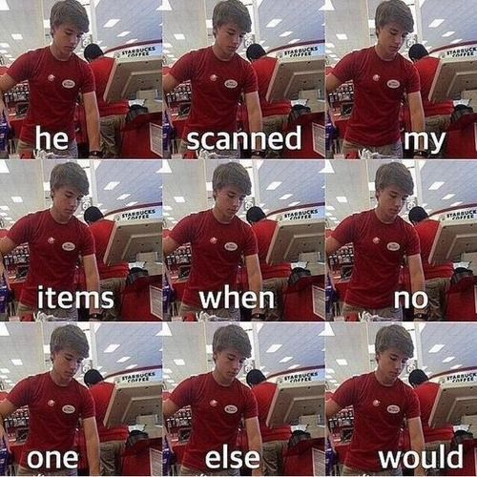

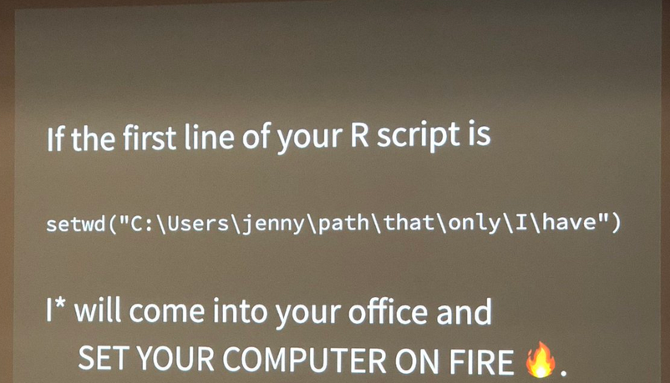

BULLSEYE!
Hit reproducibility with t a r g e t s in R
Murphy John
2025-09-25
rm(list=ls())

Slide 2


Chronic Sisyphean coding loop
Write code
Run entire project and wait
Discover an error
Or your advisor tells you to change your analysis🙂
Clear working directory (maybe)
Repeat

Slide 3
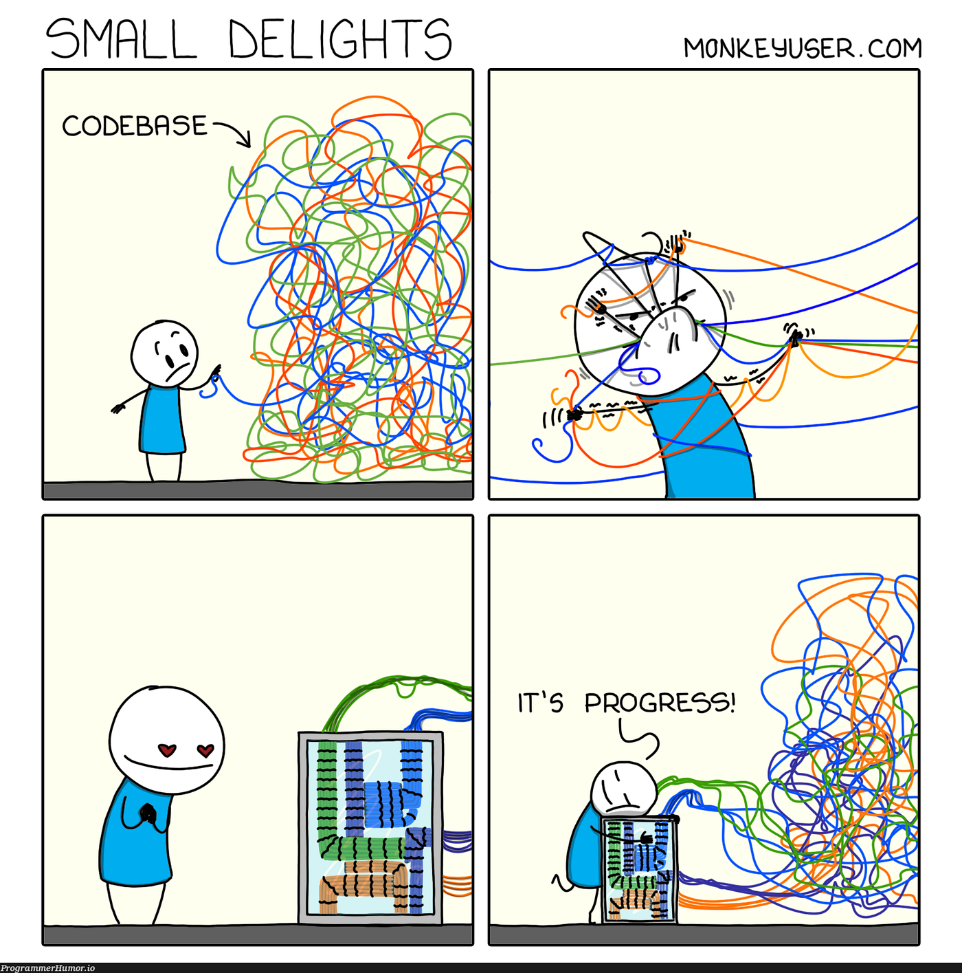
What is t a r g e t s?
targets is an R package that organizes and tracks all components of an analytical pipeline
Monitors code and outputs so results stay current when changes are made
Re-runs only modified steps and their downstream dependencies
Flags steps with pending changes so you know exactly where to work
An organized workflow is an efficient and reproducible workflow!

Slide 4
Things I love about t a r g e t s😍
Functional coding feels weird at first, but it’s SO efficient
Everything gets saved (and updated) automatically in the “_targets/” folder, so you don’t end up with a million random files floating around
Having one “master” file with all your targets makes the whole workflow way more organized and easier to follow
Targets has parallel processing built in, so things run faster, and you don’t have to mess with setting it up yourself
Reproducibility is basically forced along the way so when you come back months later (or hand it off to someone else), the pipeline is clear and still works

Slide 5


Still haven’t turned your head?
a hot new bombshell (function) has entered the villa
tar_visnetwork()

Slide 6
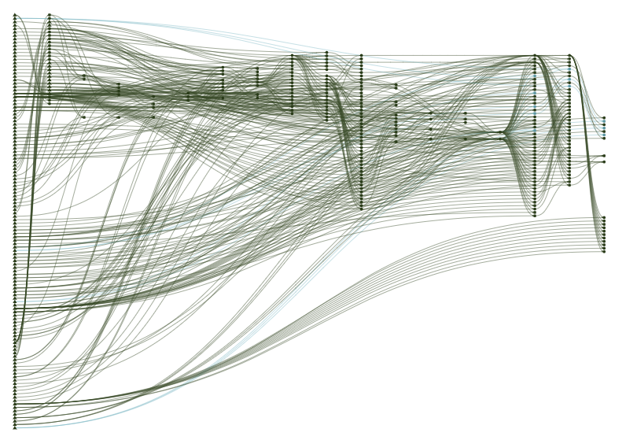
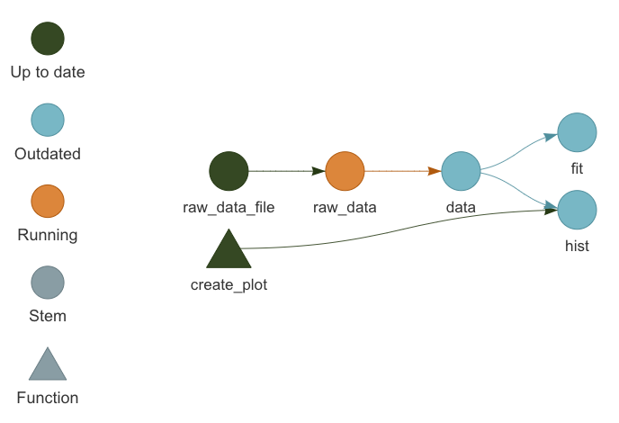
tar_visnetwork()
Visualizes your entire pipeline with a dependency graph (similarish to a DAG)
😮
Who cares?! 🥱
That pipeline is super straightforward. 😴
I can easily remember that! 😏

Slide 7
Setting up a t a r g e t s project

Slide 8
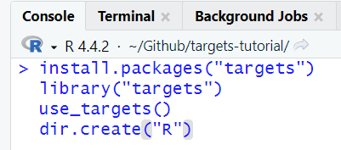
Set up
Create an R project
Install and load the targets package
Run “use_targets()” to create a “_targets.R” file
Create a folder called “R” where you will store custom functions

Slide 9
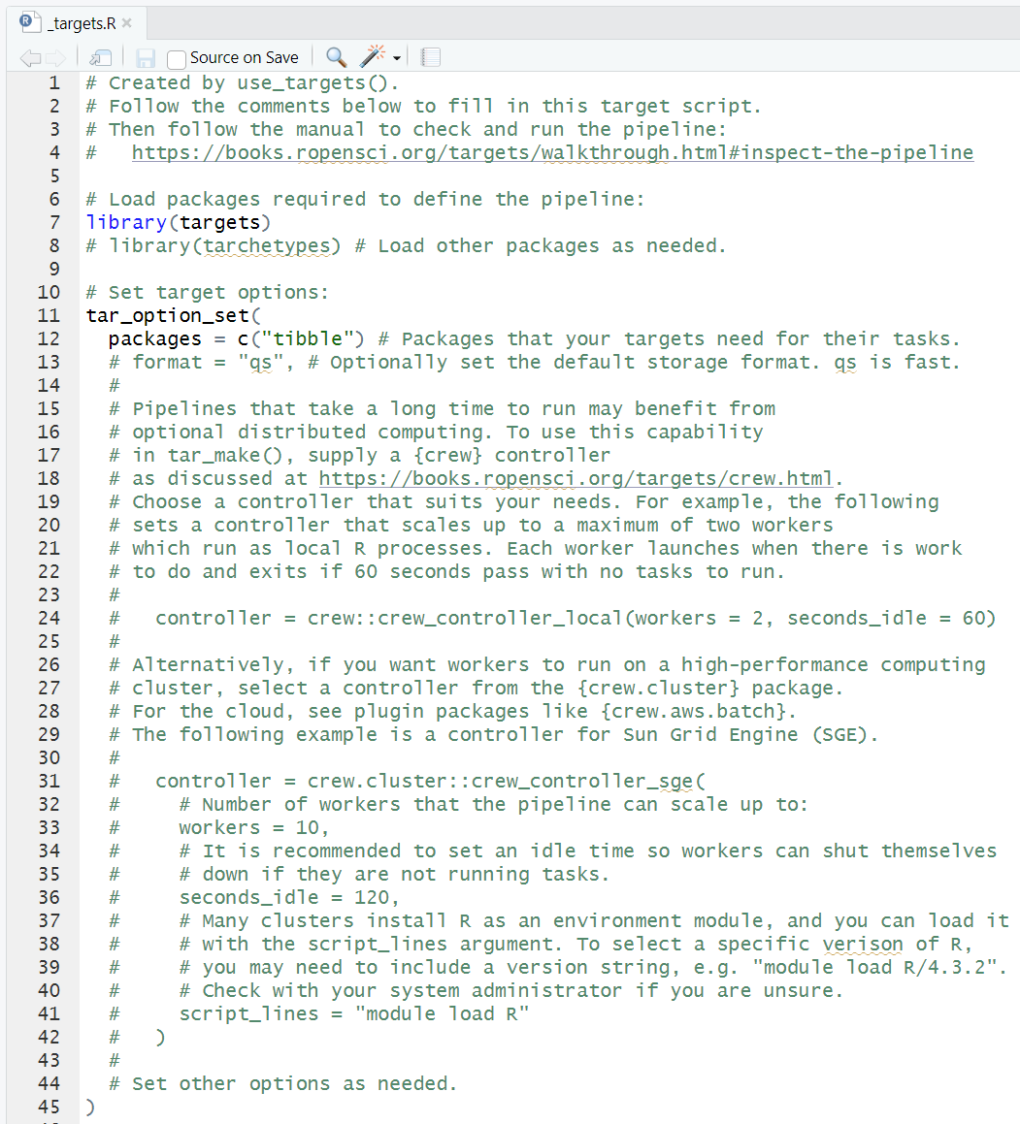
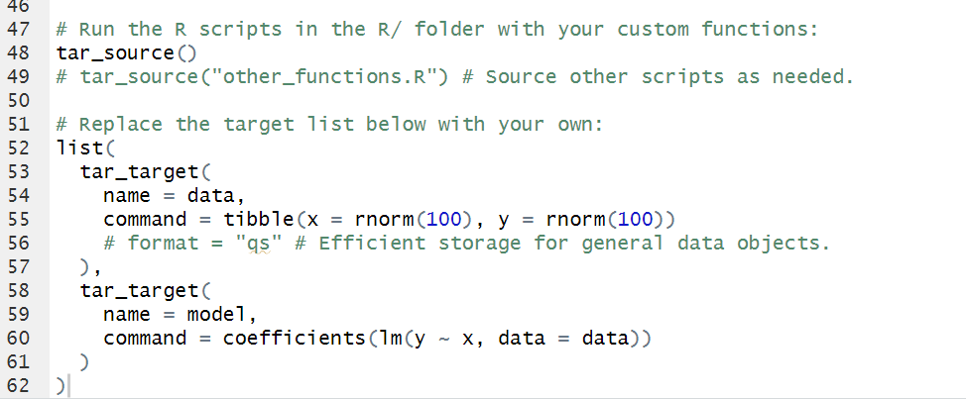
_targets.R
The “master” file of your projects
Load packages
Set targets options
Load custom functions
Set up targets pipeline

Slide 10
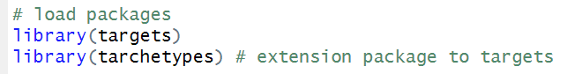
Things I always set up in the _targets.R file
Load `targets` and `tarchetypes`

Slide 11
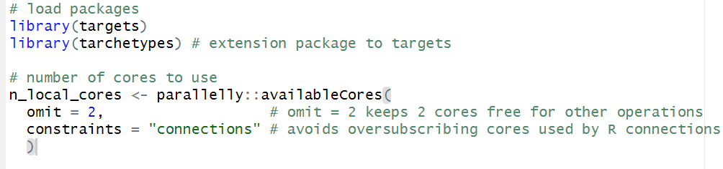
Things I always set up in the _targets.R file
Load `targets` and `tarchetypes`
Maximize the number of CPU cores being used

Slide 12
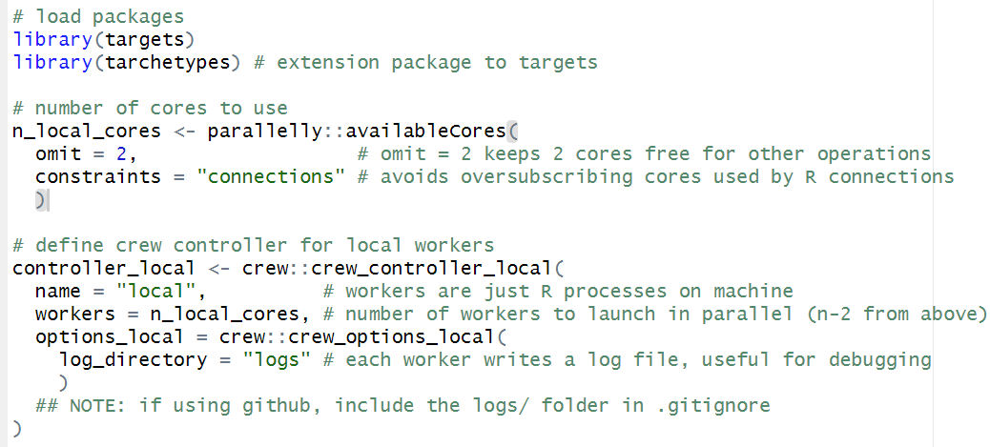
Things I always set up in the _targets.R file
Load `targets` and `tarchetypes`
Maximize the number of CPU cores being used
Specify parallel processing features and write log files for debugging

Slide 13
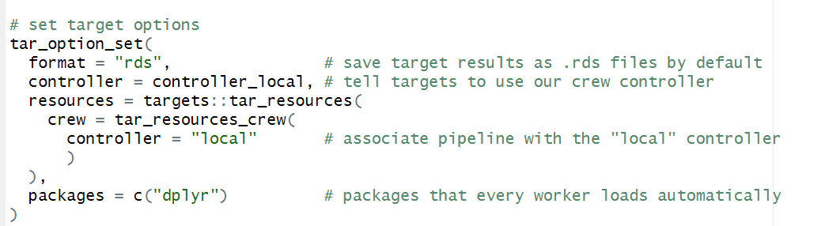
Things I always set up in the _targets.R file
Load `targets` and `tarchetypes`
Maximize the number of CPU cores being used
Specify parallel processing features and write log files for debugging
Some other `targets` specifications

Slide 14
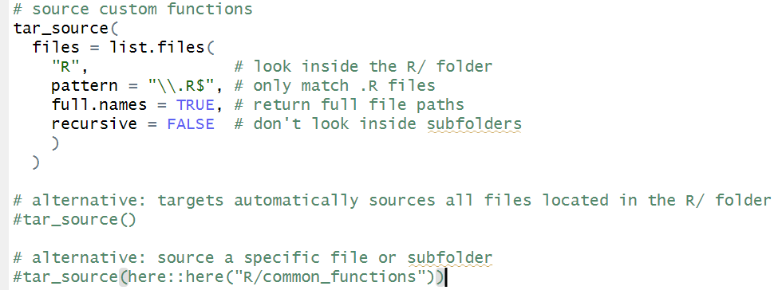
Things I always set up in the _targets.R file
Load `targets` and `tarchetypes`
Maximize the number of CPU cores being used
Specify parallel processing features and write log files for debugging
Some other `targets` specifications
Source custom functions for workflow

Slide 15
Example t a r g e t s project

Slide 16

ggplot2::diamonds dataset
Prices and other attributes of about 54,000 diamonds
How do carat, cut, color, and clarity influence diamond price?
TODO:
Load and process data
EDA
Fit a model
Plot results
Save results

Slide 17
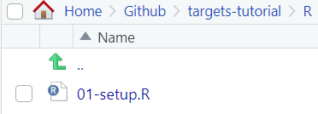
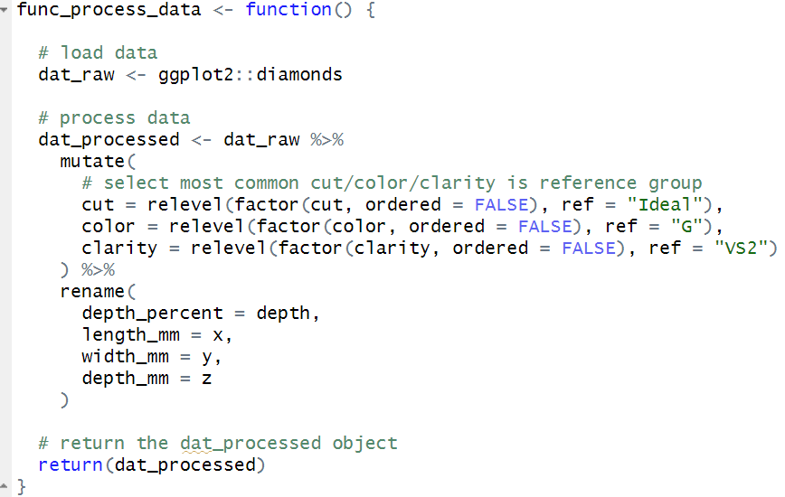
Load and process data
Write a function that loads and processes the data

Slide 18
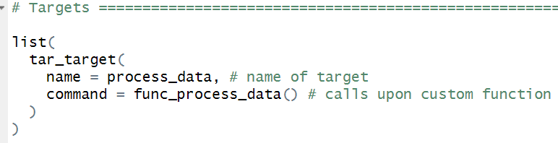
Load and process data
Write a function that loads and processes the data
Add function to a target

Slide 19
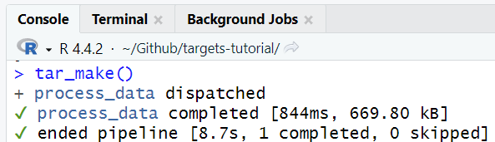
Load and process data
Write a function that loads and processes the data
Add function to a target
Run t a r g e t s workflow!

Slide 20
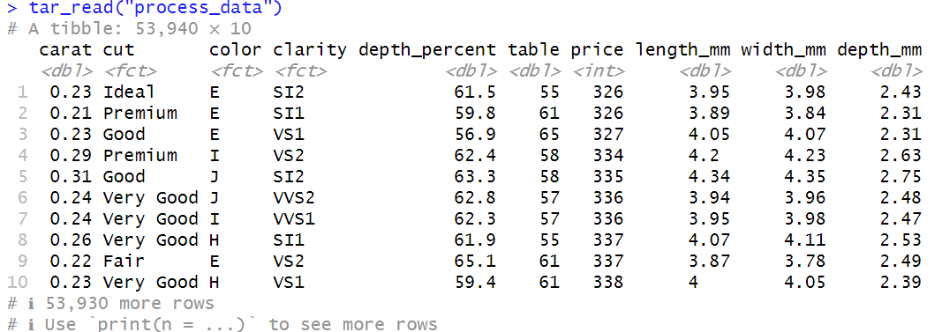
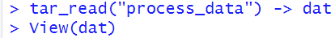
Load and process data
Write a function that loads and processes the data
Add function to a target
Run t a r g e t s workflow!

Slide 21
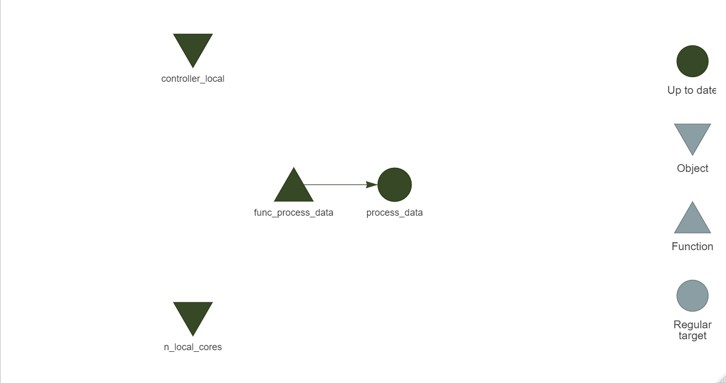
Load and process data
Write a function that loads and processes the data
Add function to a target
Run t a r g e t s workflow!

Slide 22
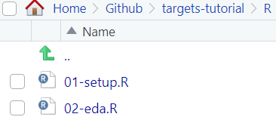
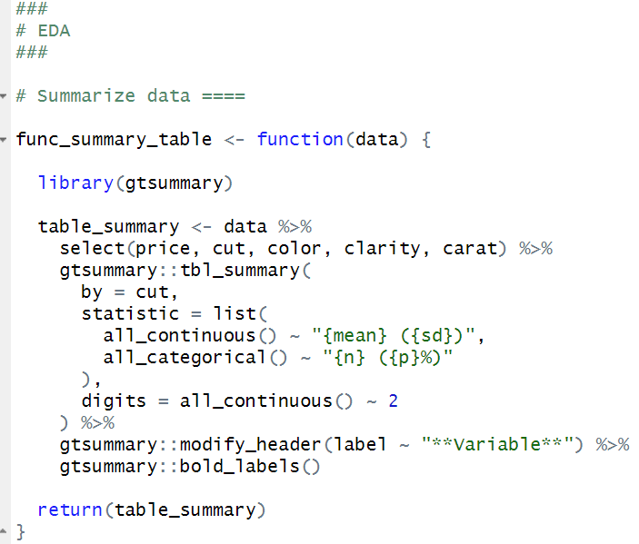
EDA
Function that creates summary table

Slide 23
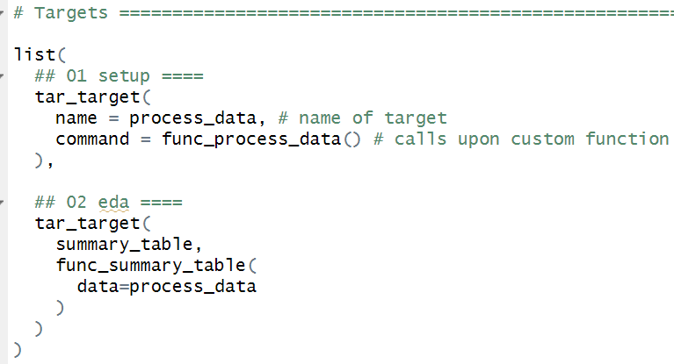
EDA
Function that creates summary table
Add function to a separate target

Slide 24
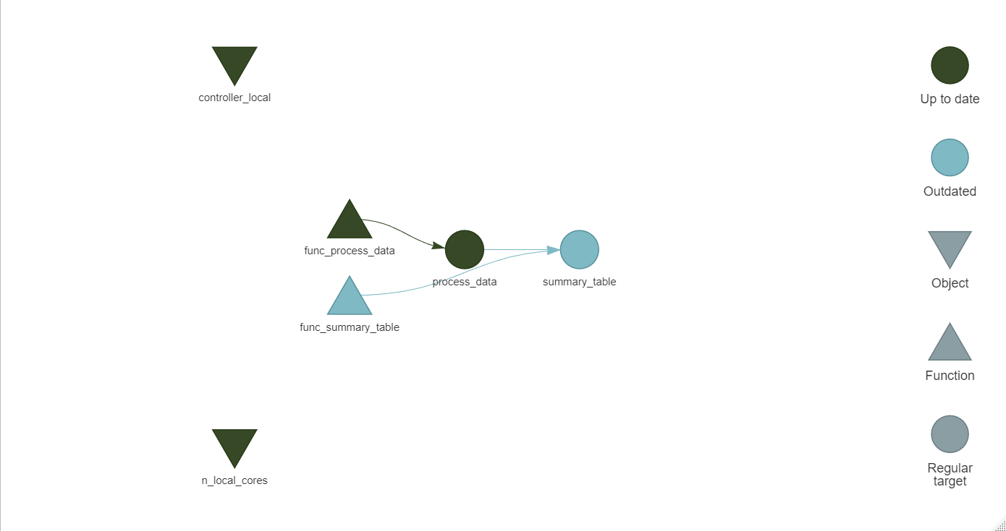
EDA
Function that creates summary table
Add function to a separate target

Slide 25
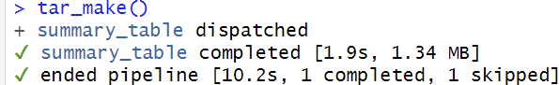
EDA
Function that creates summary table
Add function to a separate target
Run t a r g e t s workflow!

Slide 26
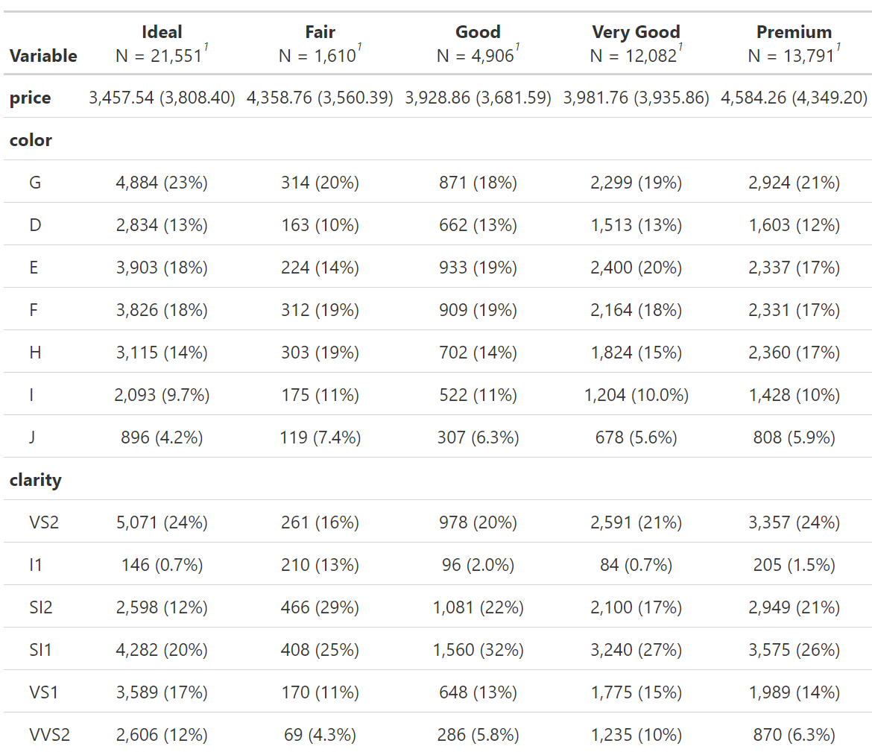
EDA
Function that creates summary table
Add function to a separate target
Run t a r g e t s workflow!

Slide 27
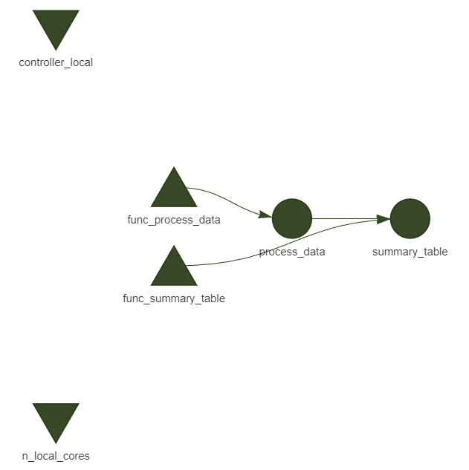
EDA
Function that creates summary table
Add function to a separate target
Run t a r g e t s workflow!

Slide 28
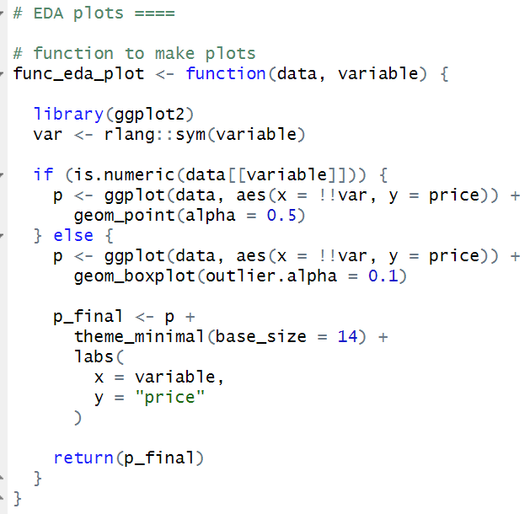
EDA further
Function that creates eda plots of a given variable by price

Slide 29
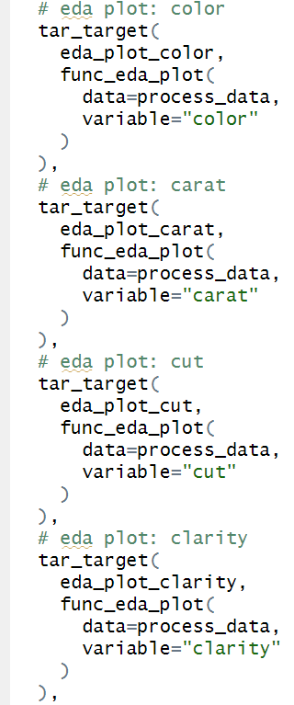
EDA further
Function that creates eda plots of a given variable by price
Create a target for each plot

Slide 30
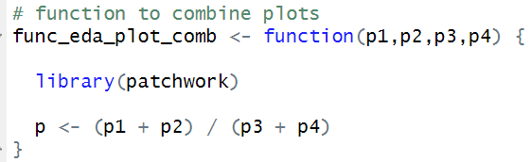
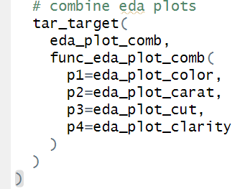
EDA further
Function that creates eda plots of a given variable by price
Create a target for each plot
Function and target that combines plots

Slide 31
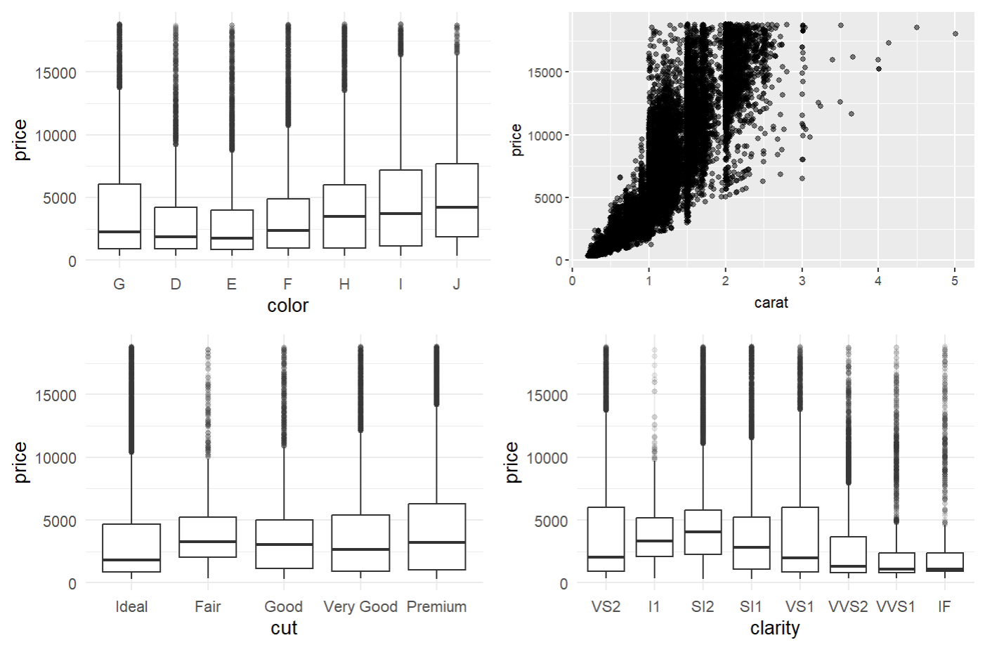
EDA further
Function that creates eda plots of a given variable by price
Create a target for each plot
Function and target to combine plots
Run t a r g e t s workflow!

Slide 32
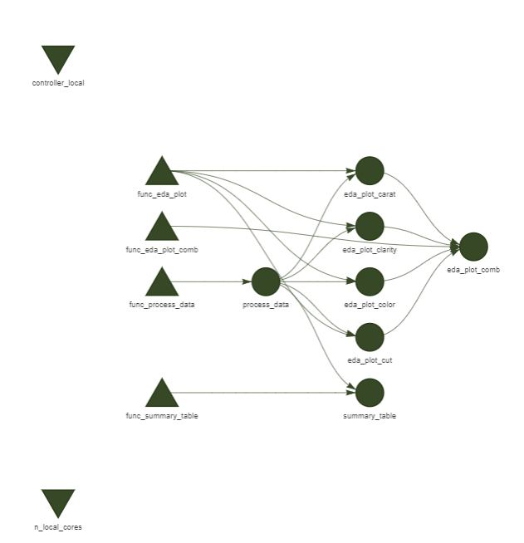
EDA further
Function that creates eda plots of a given variable by price
Create a target for each plot
Function and target that combines plots
Run t a r g e t s workflow!

Slide 33
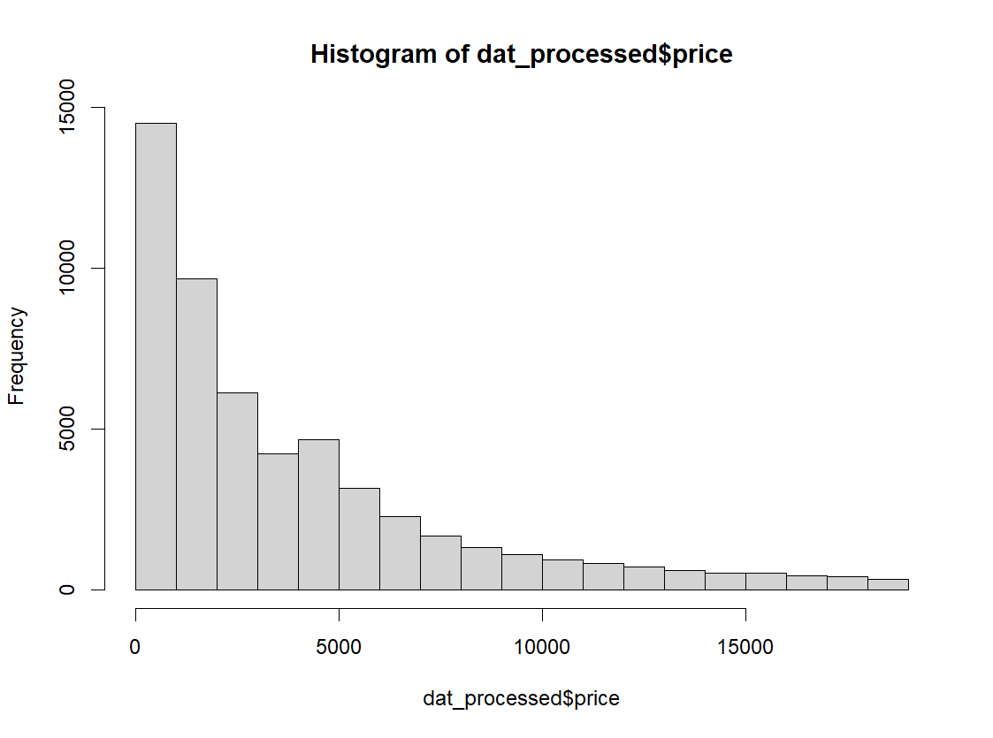
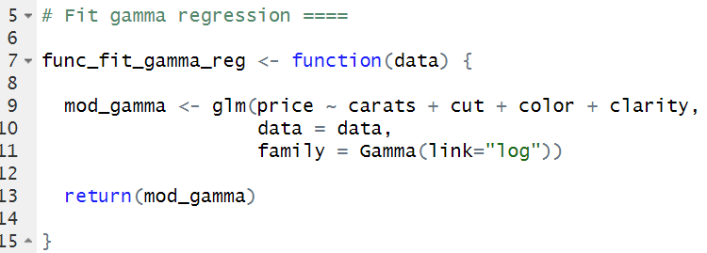
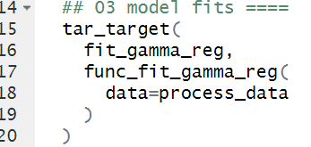
Fit a model
Data are right-skewed so fit gamma regression model with carat, cut, color, and clarity as predictors of price

Slide 34
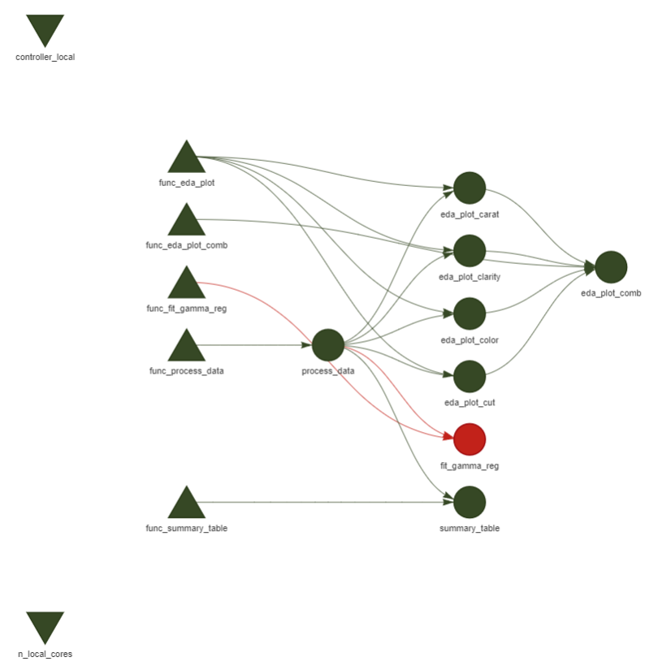
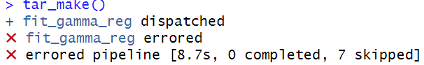
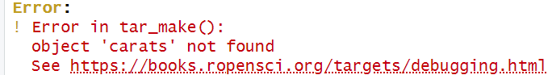
ERROR

Slide 35
Debugging in t a r g e t s
Debugging in R is easiest when the session is interactive ie you have full control over the code and objects in the environment, and you are free to tinker and test until you find the issue
However, we intentionally use a non-interactive setup with targets because it is more automated and reproducible
In this case, the targets error message was pretty informative but that doesn’t always happen
Debugging your functions in targets sometimes requires a few extra steps

Slide 36
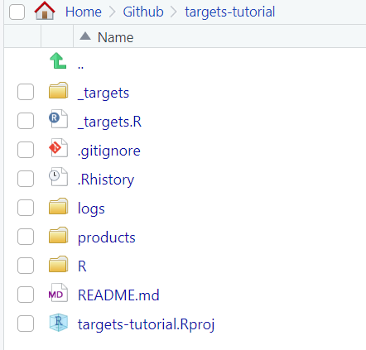
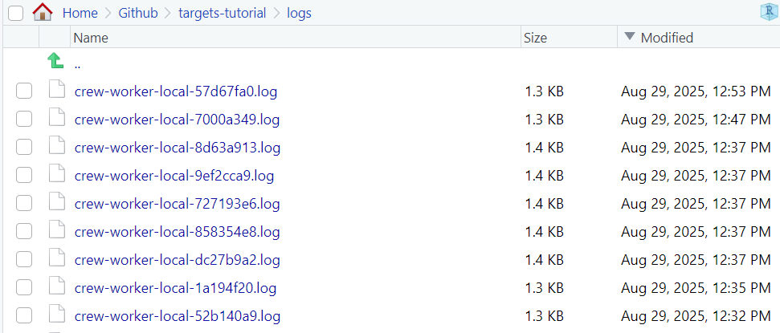
Debugging in t a r g e t s
Recall: when we defined the crew controller for local workers, we asked each worker to create a log file and store it in the /logs folder
When you encounter an error with little explanation, go to the most recent log and you’ll find a more detailed report

Slide 37
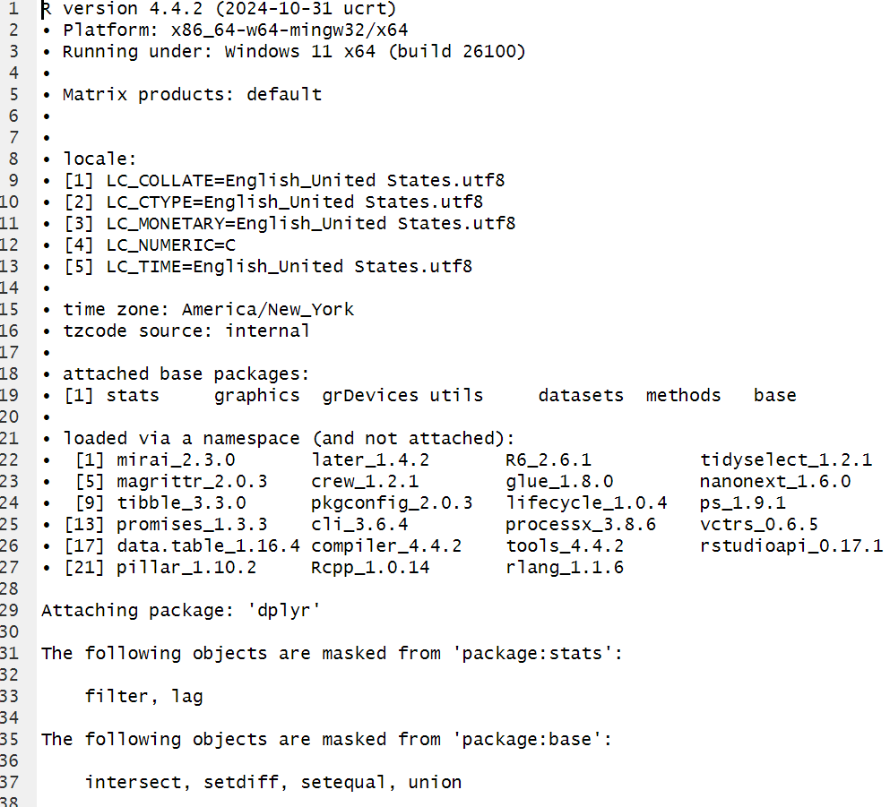
Debugging in t a r g e t s
Lots of session info that can be useful depending on what you’re doing
Not super informative for debugging in this case because the code is so simple but can be very helpful for more complex analyses.

Slide 38
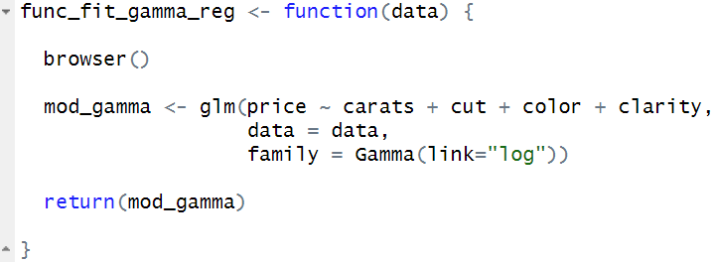
Debugging in t a r g e t s
Pause the pipeline with browser()
Insert browser() into your errored function

Slide 39
Debugging in t a r g e t s
Pause the pipeline with browser()
Insert browser() into your errored function and save
Call tar_make() with callr_function = NULL, use_crew = FALSE, and as_job = FALSE
This runs the whole pipeline in your interactive session without launching a new callr::r() process, parallel crew workers, or an RStudio job

Slide 40
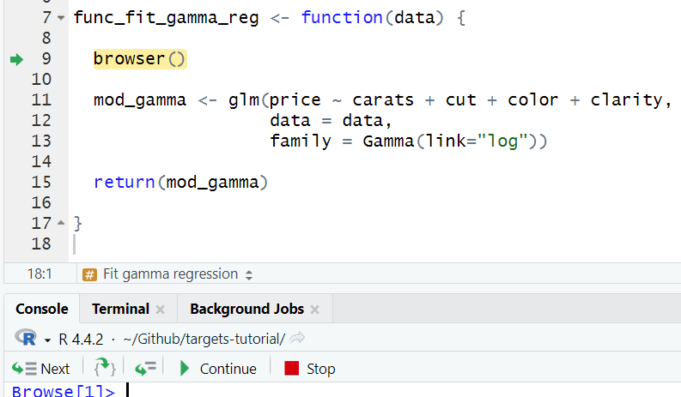
Debugging in t a r g e t s
Call tar_make() with callr_function = NULL, use_crew = FALSE, and as_job = FALSE

Slide 41
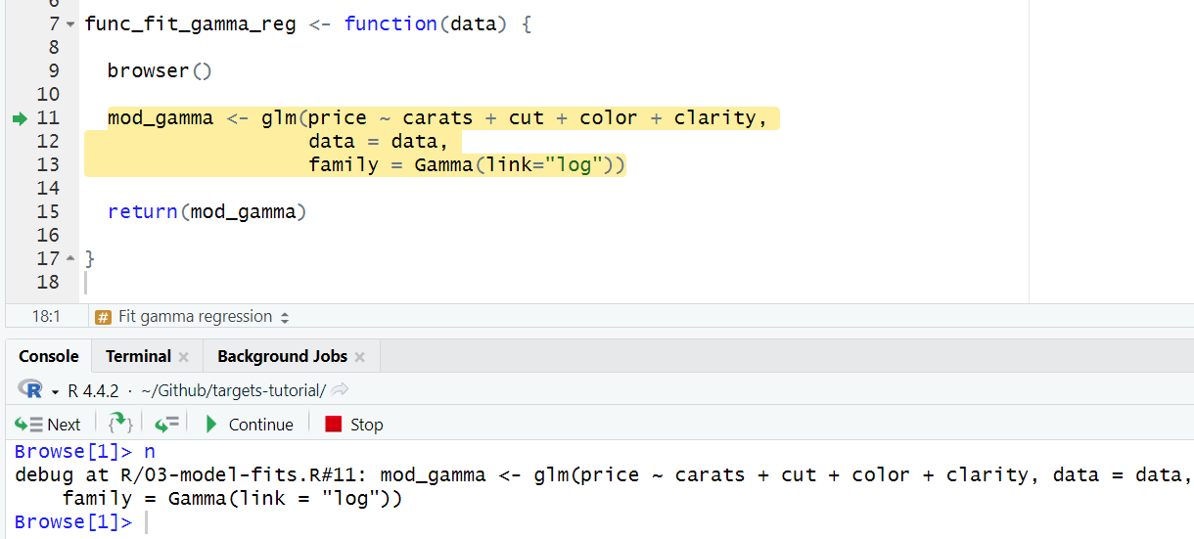
Debugging in t a r g e t s
Call tar_make() with callr_function = NULL, use_crew = FALSE, and as_job = FALSE

Slide 42
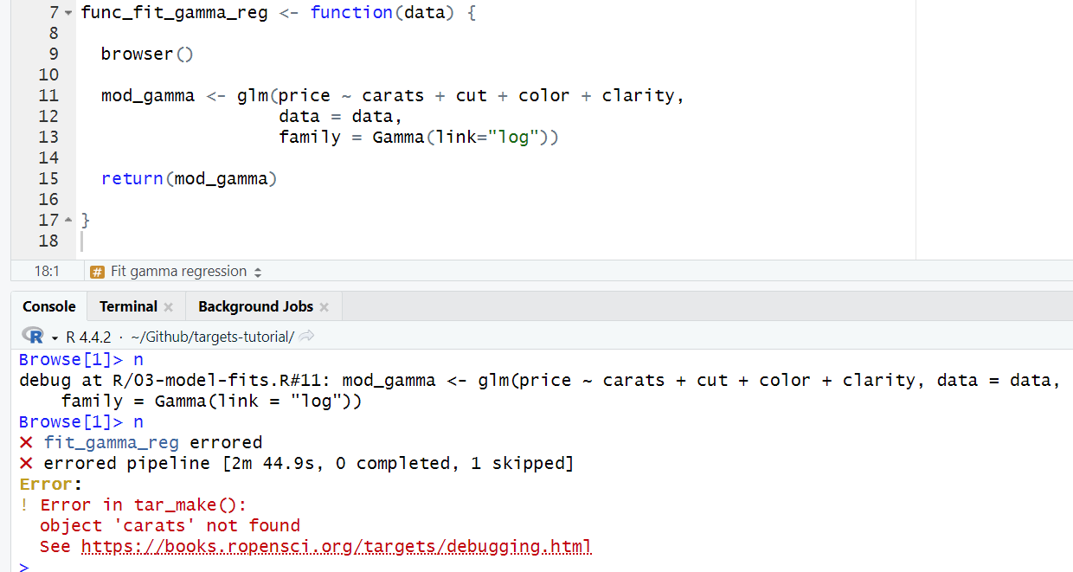
Debugging in t a r g e t s
Call tar_make() with callr_function = NULL, use_crew = FALSE, and as_job = FALSE

Slide 43
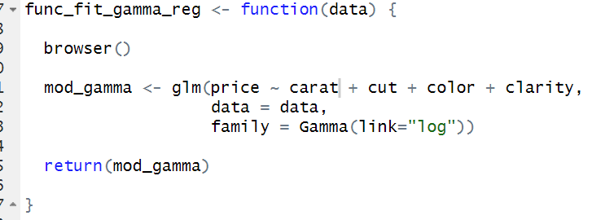
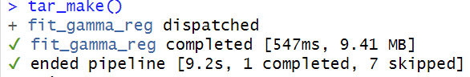
Debugging in t a r g e t s
We’ve located the line that contains the error
Replace the misspelled variable and rerun tar_make()

Slide 44
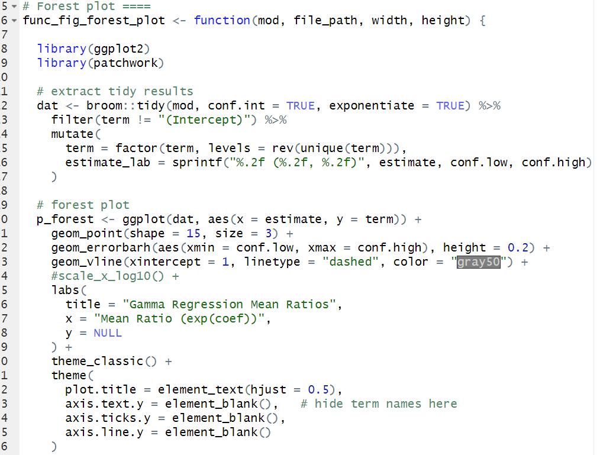
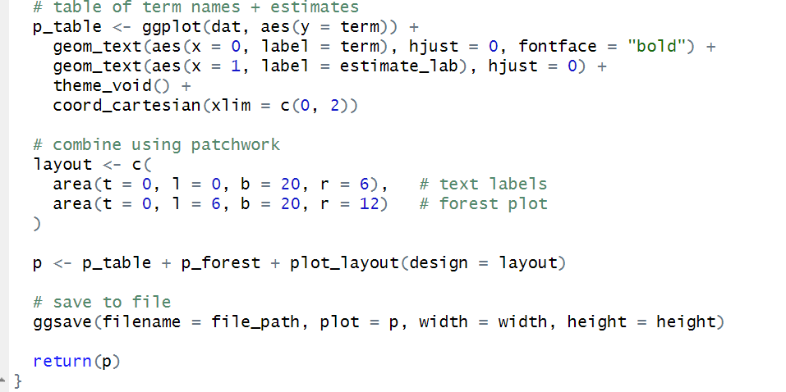
Results
Function to make an interpretable figure of our results

Slide 45


Results
Function to make an interpretable figure of our results
Make a target and run

Slide 46


Results
Function to make an interpretable figure of our results
Make a target and run

Slide 47
Now we have an efficient, organized, and fully reproducible workflow!

Slide 48
Lastly…using t a r g e t s with the UGA sapelo2 cluster
Sapelo2 is high‐performance computing (HPC) Linux cluster run by the Georgia Advanced Computing Resource Center (GACRC) at UGA
Ie a super-computer
It has about 38,000 CPU cores (compared to your laptop or desktop which probably has 4-16) and a bunch of different nodes
More cores + more nodes = super fast and efficient computing😊
Any UGA student or faculty member can use it once you take a short training course

Slide 49


Using t a r g e t s with the UGA sapelo2 cluster
As an example, lets run the diamond pipeline on the cluster:
Invalidate the targets that have already been run (and push changes to github)

Slide 50

Using t a r g e t s with the UGA sapelo2 cluster
As an example, lets run the diamond pipeline on the cluster:
Log into the cluster and change to the scratch/ directory

Slide 51
Using t a r g e t s with the UGA sapelo2 cluster
As an example, lets run the diamond pipeline on the cluster:
Log into the cluster and change to the scratch/ directory
Clone your github project to sapelo2 (before logging in)
Note that you need to generate a personal access token in github and give it repo scope

Slide 52

Using t a r g e t s with the UGA sapelo2 cluster
As an example, lets run the diamond pipeline on the cluster:
Log into the cluster and change to the scratch/ directory
Clone your github project to sapelo2 (before logging in)
Write your slurm script
Note: make sure all necessary packages are installed in R

Slide 53
Using t a r g e t s with the UGA sapelo2 cluster
As an example, lets run the diamond pipeline on the cluster:
Log into the cluster and change to the scratch/ directory
Clone your github project to sapelo2 (before logging in)
Write your slurm script
Submit your job

Slide 54

Using t a r g e t s with the UGA sapelo2 cluster
As an example, lets run the diamond pipeline on the cluster:
Log into the cluster and change to the scratch/ directory
Clone your github project to sapelo2 (before logging in)
Write your slurm script
Submit your job
Push back to Github

Slide 55
Using t a r g e t s with the UGA sapelo2 cluster
As an example, lets run the diamond pipeline on the cluster:
Log into the cluster and change to the scratch/ directory
Clone your github project to sapelo2 (before logging in)
Write your slurm script
Submit your job
Push back to Github
Note: you might get an error about github not recognizing you. Just add your name and email

Slide 56


Using t a r g e t s with the UGA sapelo2 cluster
As an example, lets run the diamond pipeline on the cluster:
Log into the cluster and change to the scratch/ directory
Clone your github project to sapelo2 (before logging in)
Write your slurm script
Submit your job
Push back to Github
GitKraken via my desktop:

Slide 57

Using t a r g e t s with the UGA sapelo2 cluster
As an example, lets run the diamond pipeline on the cluster:
Log into the cluster and change to the scratch/ directory
Clone your github project to sapelo2 (before logging in)
Write your slurm script
Submit your job
Push back to Github
Check pipeline status
What?! Why are the targets outdated???

Slide 58
Using t a r g e t s with the UGA sapelo2 cluster
Even though you might connect to Sapelo2 from your desktop, t a r g e t s treats Sapelo2 and your local machine as separate environments, each with its own _targets/ cache
Basically, only use Sapelo2 to run the t a r g e t s pipeline when you have computationally expensive or large models (which you probably would do anyways).
(Unfortunately) it’s all-or-nothing: if you need to run one part of the pipeline on the cluster, you generally need to run the entire pipeline there.
Fortunately, the brilliant t a r g e t s automated workflow basically forces this anyway!
In theory, you could transfer the _targets/ cache across devices to explore model results, but for large models the files are too big to move easily and doing so via github will probably just set flames to Miller Hall🔥

Slide 59





Congratulations
You now know how to code using t a r g e t s
e
was
started
Slides and code available on my GitHub
https://github.com/murphyhjohn/targets-tutorial

